Slide 1

Tip Calculator
By Patrick Lewis

Slide 2
User stories for tip Calculator
Release 1: Core Tipping Functionality
Feature: Input Bill Amount
User Story: As a website user, I want to enter my total bill amount into an input field, so that the calculator has the base number for the tip calculation.
Feature: Select Preset Tip %
User Story: As a diner, I want to click on common tip percentage buttons (like 15% or 20%), so that I can calculate my tip quickly and easily.
Feature: Calculate Tip & Total
User Story: As a user, I want to view the results, so that I know the exact amount to tip and the total amount to pay.
Feature: Display Final Results
User Story: As a customer, I want to see the tip amount and the total bill in a large font, so that I have a better understanding of the meal price and tip breakdown.

Slide 3
User stories continued
Release 2: Enhanced Flexibility & Sharing
Feature: Split the Bill / Calculate Per-Person Amount
User Story: As a diner out with friends, I want to input the number of people I'm paying with, so that I can easily figure out how much each person needs to pay.
Feature: Input Custom Tip %
User Story: As a diner who wants to be precise with their tip, I want to type my own percentage amount into an input box, so that I can tip what I feel is fair and make my own choice.
Feature: Rounding Feature
User Story: As a diner who wants to make the final bill an even amount, I want to press a 'Round Total' button after the calculation, so that the final number is a simple, even total that's easier to pay.

Slide 4

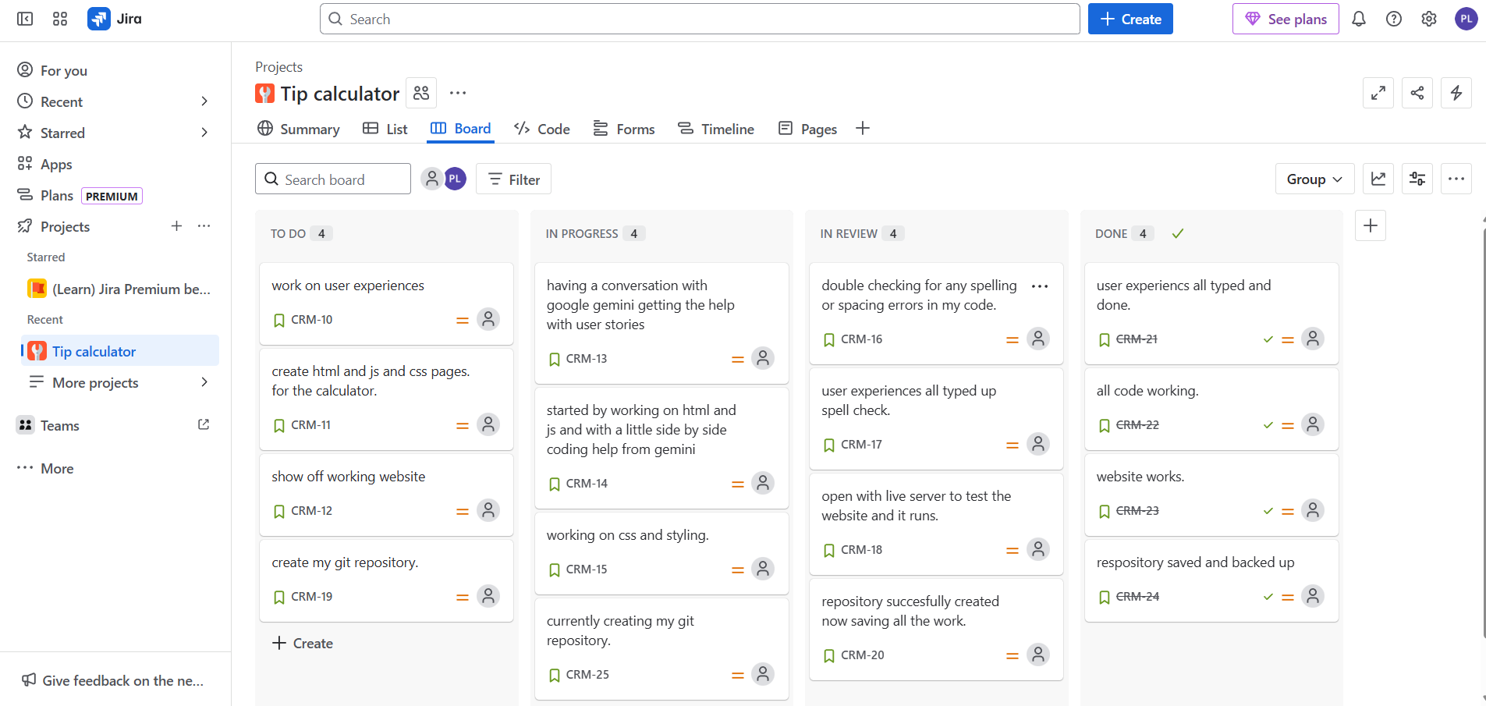
Scrum board

Slide 5

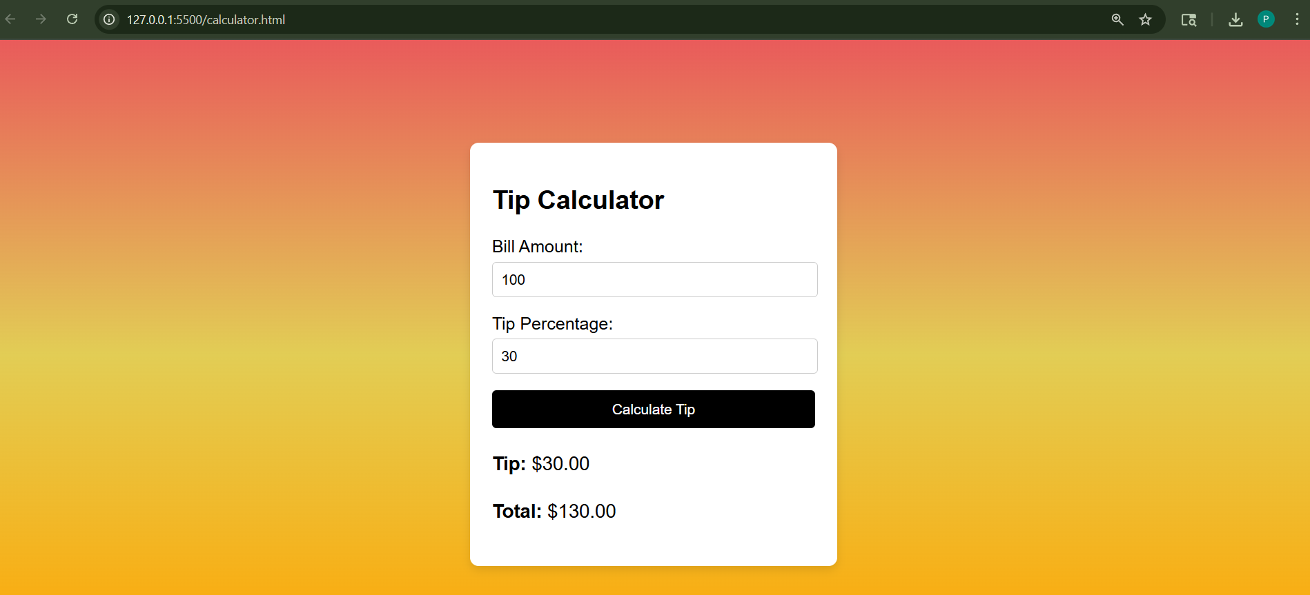
Tip calculator website

Slide 6
Sources I used
Google Gemini 2.5pro
Git hub
Jira to create my scrum board
Microsoft word online to type up my user stories

